Slide 1
The Outliers
Members:
Satyarajsinh Jadeja
Hiren Thakkar
Swapnil Sheth
Vijita Dudhrejiya
Monisha Charaniya
Rimmi Parmar
Prayosha Food Services Pvt Ltd(Petpooja)

Slide 2
Assumptions
Data Availability: Historical sales data and ingredient images are accessible for training AI models.
Camera Infrastructure: Restaurants have installed cameras for real-time inventory and spoilage monitoring.
Stable Internet: Consistent connectivity is available for cloud-based AI processing and analytics.
Staff Training: Kitchen staff are trained to use the AI system effectively.
Ingredient Consistency: Food items have standardized labeling and packaging for accurate recognition.
***You can add few more slides for adding references, if required***

Slide 3
1. Computer Vision for Smart Inventory Management
Scans Image or Real-Time Camera Feed and extracts:
Item names from the feed
Spoilage Status(Expired, Soon to be Expired or Fresh)
Quantity of items present in the image
***You can add few more slides for adding references, if required***

Slide 4
List the tech used to address problem statement 1
Front-End: HTML ,CSS and Javascript
Back-End: Flask
AI/ML Model(APIs used): YOLO v8, Gemini API
Database: JSON
Datasets:
Pantry Object Detection
(https://universe.roboflow.com/yolo-1eope/pantry-wlooe/dataset/1)
Spoiled_data (self-made)
Real time stock detection : https://app.roboflow.com/satyaraj/food-waste-detection-jghxg-kzif0/models/food-waste-detection-jghxg-kzif0/1

Slide 5
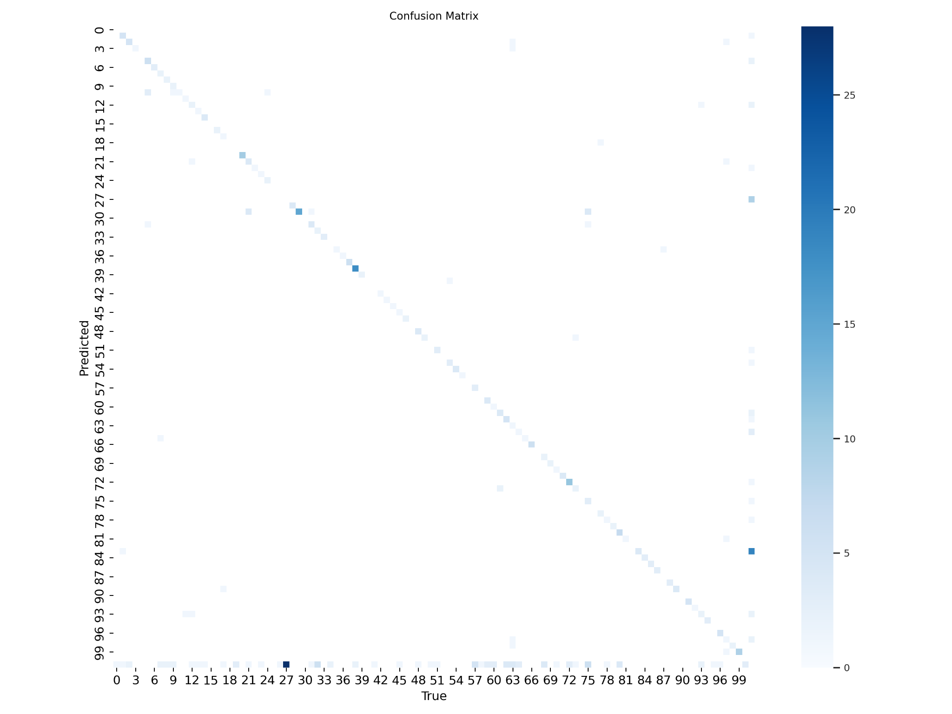
List the tech used to address problem statement 1
Accuracy:
Precision (0.834): Of all the predicted boxes, 83.4% were correct.
Recall (0.665): Of all the ground truth objects, 66.5% were detected.

Slide 6
List the tech used to address problem statement 1
Research References :
Roboflow
Open AI

Slide 7
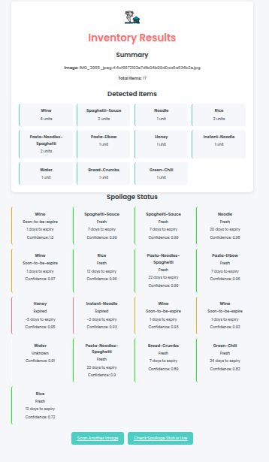
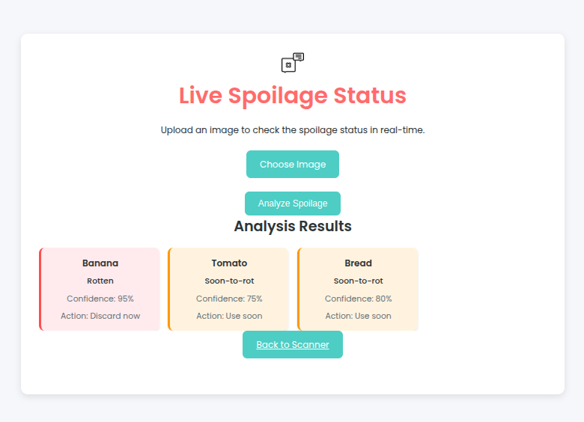
Attach screenshots for Problem statement 1
***You can add few more slides for adding references, if required***

Slide 8
2. AI-Powered Demand & Waste Prediction
Forecast product needs accurately, reducing overstock and understock situations.
Minimize food waste by aligning supply with real-time demand trends and shelf-life insights

Slide 9
List the tech you have used to address problem statement 2
Front-End: HTML ,CSS and Javascript
Back-End: Flask
AI/ML Model(APIs used): Q-learning, Random Forest Regression, LSTM
Database: -
Datasets: dynamic_inventory_dataset , waste_dataset, Grocery_Inventory
***You can add few more slides for adding references, if required***

Slide 10
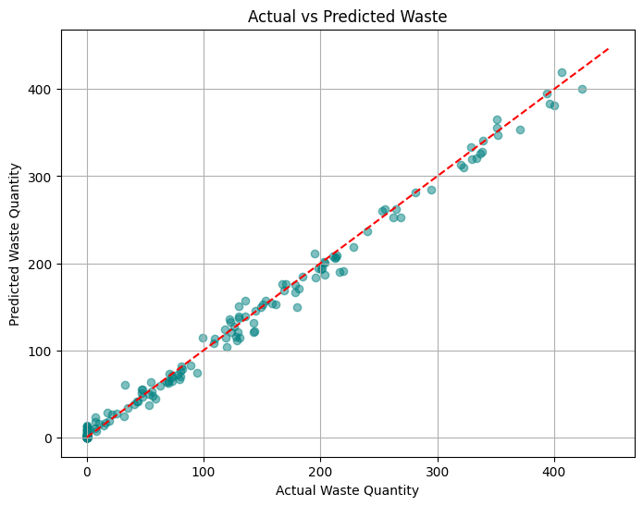
List the tech you have used to address problem statement 2
Waste_prediction
MAE: 5.73266151492604
RMSE: 8.647355475411857
R² Score: 0.9941739133917524
***You can add few more slides for adding references, if required***

Slide 11
3. Intelligent Menu Optimization
Recommends dishes from surplus or near-expiry ingredients to reduce waste.
Adjusts prices or suggests alternatives to ensure profitability.
Generates new recipes based on available ingredients
***You can add few more slides for adding references, if required***

Slide 12
List the tech you have used to address problem statement 3
Front-End: HTML,CSS, JAVASCRIPT
Back-End: FLASK,Python
AI/ML(API):-Gemini 2.0
Datasets :
sales_weekly(self made),
ingredients(self made),
Recipes(self made),
selling_price data(self made)
***You can add few more slides for adding references, if required***

Slide 13
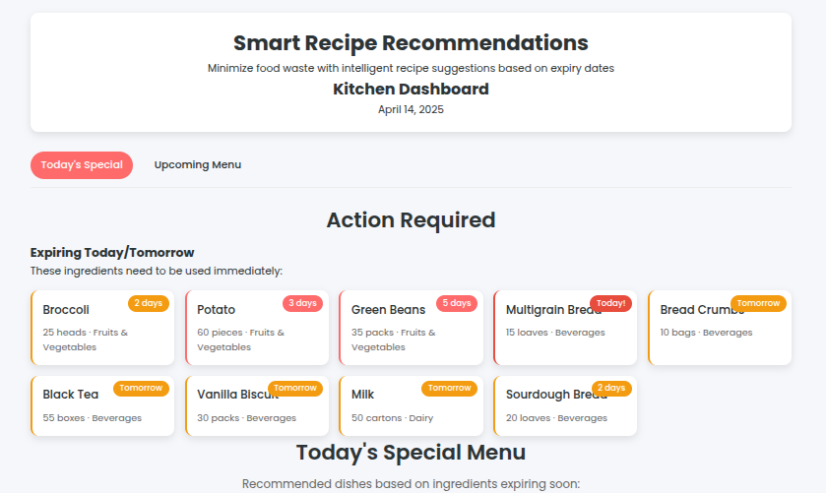
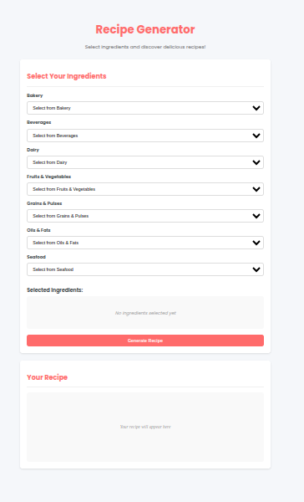
Attach screenshots for Problem statement 3
***You can add few more slides for adding references, if required***

Slide 14
4. Vision-Powered Waste Analysis & Reporting
User will give image of waste on plate, and than it will predict the waste of that plate and give the gram and analysis of the waste
User will upload the image of kitchen than how many waste will happened while making the food or in storage for that it will create heatmap and distribution graph and the percentage of waste in table

Slide 15
List the tech you have used to address problem statement 4
Front-End: HTML, CSS, JS
Back-End: Flask
AI/ML: YOLOv8x, Gemini-flash-2.0
Database: JSON
Datasets:
dataset_name food-waste-detection
https://universe.roboflow.com/food-1b74y/food-waste-detection-jghxg
***You can add few more slides for adding references, if required***

Slide 16
List the tech you have used to address problem statement 4
Overall Metrics (Epoch 50 - Final Epoch):
Box Precision (P): 0.834
Box Recall (R): 0.665
mAP@0.5: 0.778
mAP@0.5:0.95: 0.658
***You can add few more slides for adding references, if required***

Slide 17
List the tech you have used to address problem statement 4
Research references:
Open AI
https://www.analyticsvidhya.com/blog/2023/01/food-waste-management-ai-driven-food-waste-technologies/
Roboflow
https://www.analyticsvidhya.com/blog/2023/01/food-waste-management-ai-driven-food-waste-technologies/

Slide 18
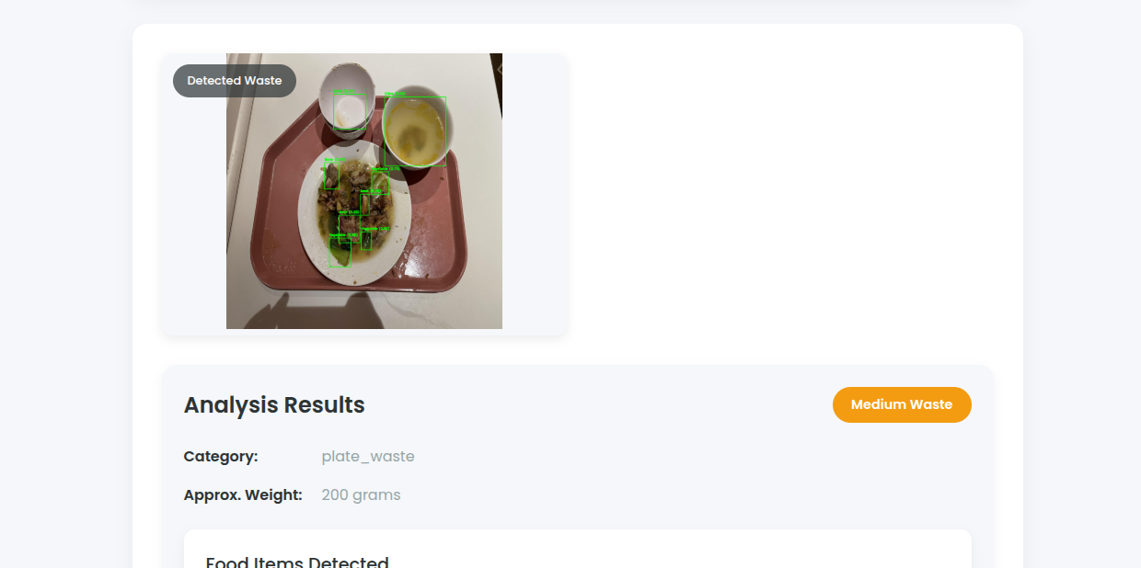
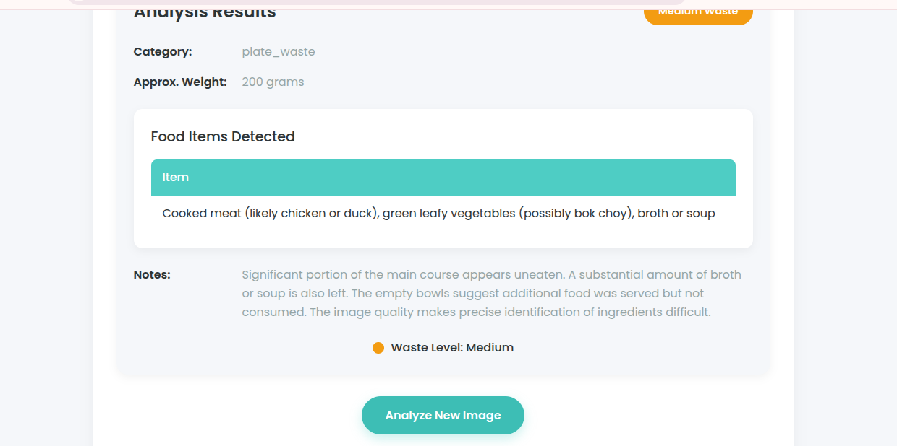
Attach screenshots for Problem statement 4

Slide 19
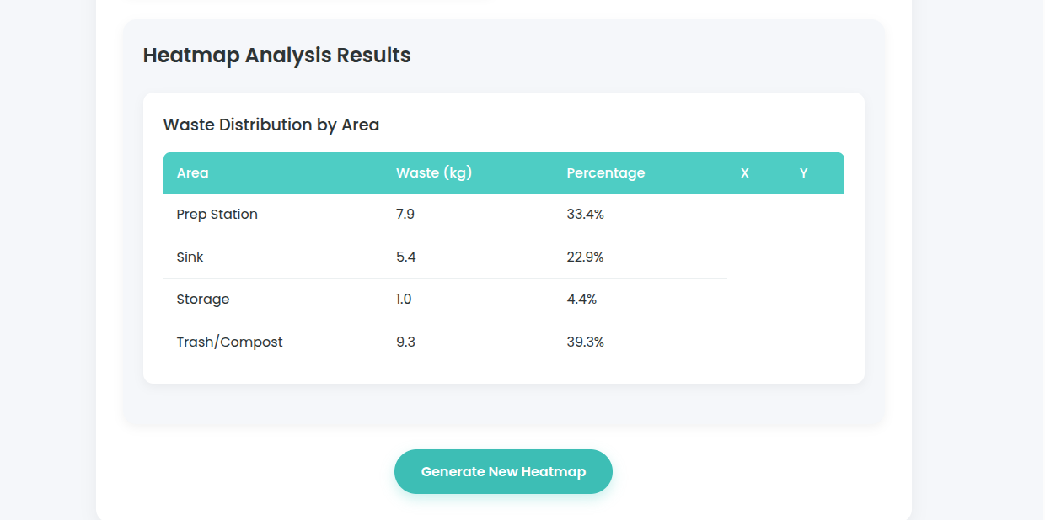
Attach screenshots for Problem statement 4

Slide 20
Thank you!

